Slide 1
Fair Online Scheduling for Selfish Jobs on Heterogeneous Machines
Introduction
Discusses concepts related to OS and Algorithms
Heterogeneous Machines:
unrelated machines, running with different speed
no centralized scheduling,
and jobs can have completely different processing time on each machines
i.e. a DS environment and not a multi-core environment
Objective of Paper?
Notes:
Heterogeneous computing refers to systems that use more than one kind of processor or cores.

Slide 2
Fair Online Scheduling for Selfish Jobs on Heterogeneous Machines
Selfish Behavior of Jobs
Jobs Choose Machines That Give them the Earliest Completion Time:
(In one research: Each job knows the processing lengths of other jobs)
Assumption:
- upon the arrival each job selfishly and irrevocably selects a machine which minimizes its own
flow time looking at only the sets of jobs assigned to each machine
- Local Scheduling Policy (advantage)

Slide 3
Fair Online Scheduling for Selfish Jobs on Heterogeneous Machines
The selfish behavior of jobs may arise be­cause the jobs are submitted by self-interested clients
Selfish Behavior is a Greedy Behavior
What is a Greedy behavior?
(Example: dispatching of web page to the server with least load
Advantage: minimizes execution time/completion time)
Problem with the Selfish Behavior?
Guess which scheduling can be suitable for SELFISH JOBS ??

Slide 4
Selfish Jobs (Contd…)
Selfish Jobs are trying to finish quickly
Fast Execution is the right of Job which needs Urgent Attention
Selfish Jobs can have fake Motives
Example [1]: We want to both allow agents to book usage in advance, and accommodate demand that appears only at the last minute. A user can fake a medical emergency to obtain use of the car, when in fact she simply forgot to book the car for a scheduled meeting with friends. Such strategic considerations cannot be ignored in the context of systems used by multiple self-interested Agents. These agents are focused on their own objectives, and generally cannot be expected to honestly reveal the importance or urgency of their request for resources, if doing so is not in their own interest. One possibility for addressing this is to implement some sort of pricing scheme, allowing usage to be prioritized along socially desirable axes such as importance, advance booking, demand, and any other factors considered important by the relevant stakeholders. [Algorithmically Driven Shared Ownership Economies]

Slide 5
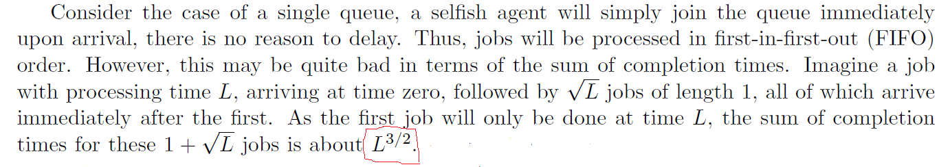

Fair Online Scheduling for Selfish Jobs on Heterogeneous Machines
To Defeat Selfish Nature of Jobs: one can use RR scheduling which gives constant time to all Jobs
Problem with RR scheduling???
Applying FIFO (FCFS) scheduling [2]:
How the sum of completion time in case of FIFO is:

Slide 6

First job has a turnaround time of L (i.e from arrival to complete
processing). After that we have sqrt (L) jobs of length 1 :
Total time is given by:
Now, applying the shortest job first [2]:

Slide 7
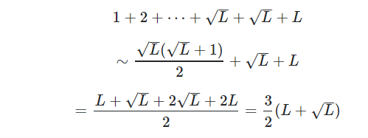
Which is equivalent to O(2L), so SJF is the best

Slide 8
Fair Online Scheduling for Selfish Jobs on Heterogeneous Machines
Online Scheduling
What does “Online ” mean?
Online Scheduling: Jobs= J1……Jn : Release time (or arrival time) = r1…..rn: Fj = Cj-rj and Fij?
Objective:
objective in online setting is to minimize the average (or equivalently total)
weighted flow time of jobs, where the :flow time of a job j is defined as the
length of time a job waits before it is completed since its arrival, multiplied
by its weight w;.
Notes:
Online Scheduling with General Cost Functions:
a collection of jobs J1, . . . , Jn arrive over time to be scheduled by one or more servers. Job Jj arrives at a nonnegative real release time rj , and has a positive real size/work pj . A client submitting a job would like their job completed as quickly as possible. In other words, the client desires the sever to minimize the flow time of their job. The flow time Fj of job Jj is defined as Cj − rj , where Cj is the time when the job Jj completes
Finally, there is a cost function fi(t) which measures the cost of completing Ji at time t

Slide 9
Explanation of Online in the Context of Signature Recognition (self Master Thesis)
Difference between Online and Offline in the Context of Scheduling [3]
In the offline setting, it is assumed that all the job specifications (i.e., processing
lengths, release times, and cost functions) are known and given to the scheduler a priori. In the online setting which we consider in this paper, the scheduler only gets to know a job specification upon its arrival to the system in which case the scheduler must make an irrevocable decision. Therefore, an immediate question here is whether an online scheduler can still achieve a performance “close” to that of the offline one despite its lack of information ahead of time.

Slide 10
Fair Online Scheduling for Selfish Jobs on Heterogeneous Machines
What is meant by Fair Scheduling?
Fair Scheduling means:
Assigning resources to jobs such that all Jobs get, on average, an equal share of resources over time.
This paper implements fairness by modifying RR (in SLAPS related to previous work):
- a job wait for at most a period of time in proportion to its size.
1

Slide 11
Contribution
The algorithm SLAPS is non-clairvoyant and local in the sense that if it is run on a machine, its scheduling decision relies only on the jobs assigned to the machine.
Our algorithm SLAPS is parameterized by a non-negative integer k, and we may use SLAPS_{k} to highlight the parameter it uses.
We show that the algorithm Smoothed Latest Arrival Processor Sharing (SLAPS), which was introduced in a recent work by yields an O(1/ꜫ)-competitive schedule when given (1 + ꜫ ) speed. We also extend our result to minimize total flow-time plus
energy consumed.

Slide 12
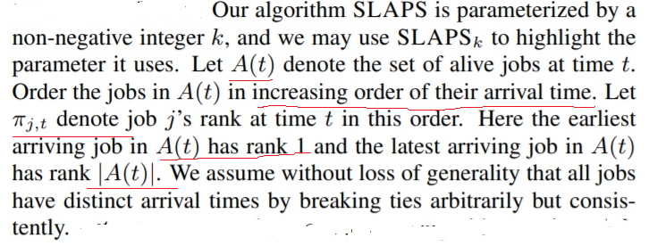
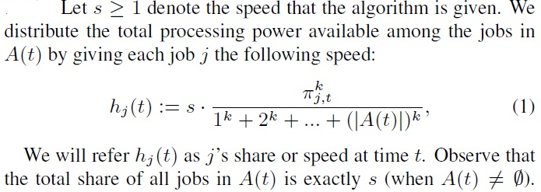
Formula for Distribution of Total Processing Power Among the Jobs

Slide 13
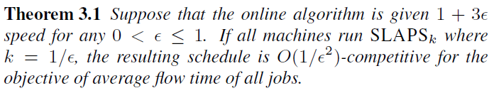
The advantage of this theorem is that it tells us the value of k, i.e.
k=1

Slide 14
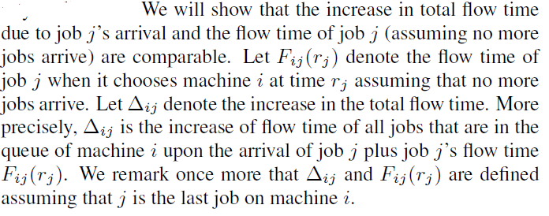



Slide 15
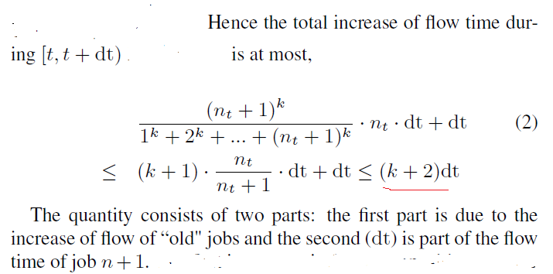
Where nt is the number of alive jobs amongst 1, 2, ……. N during [t, t+dt] time
interval

Slide 16
References
[1] Vincent Conitzer and Rupert Freeman, Algorithmically Driven Shared Ownership Economies, 2019
https://rd.springer.com/chapter/10.1007/978-3-030-18050-8_38
[2] Alon Eden† Michal Feldman‡ Amos Fiat§ Tzahi Taub, Prompt Scheduling for Selfish Agents, 2018
https://www.semanticscholar.org/paper/Prompt-Scheduling-for-Selfish-Agents-Eden-Feldman/eeed3d80aeae28102f7aa25492a5a23fc57aa7c7
[3] S. Rasoul Etesami, A Unifying Optimal Control Framework for Online Job Scheduling with General Cost Functions, 2019
https://arxiv.org/abs/1906.02644

